Slide 1

Analysis of US Dollar Index
I Chia Lee

Slide 2
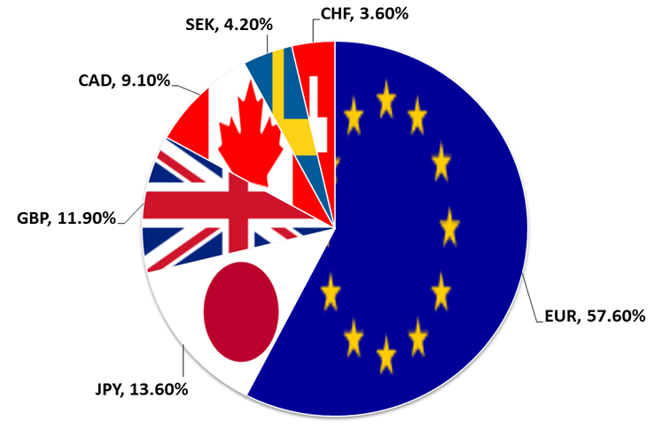
Features from Financial Market
Features: S&P 500 Index(SP500), Gold Price (Gold), Crude Oil WTI(WTI), US 10-Year Bond Yield(US10Y), the German Stock Index(DAX), the UK Stock Index(FTSE), the Japan Stock Index(Nikkei), the China Stock Index(Shanghai) and the price of USD to HKD currency(USD_HKD)
Data: 01/01/2005 to 08/02/2019
Each indicator contains closing , open, high, and low prices
Use interpolation to replace missing values

Slide 3
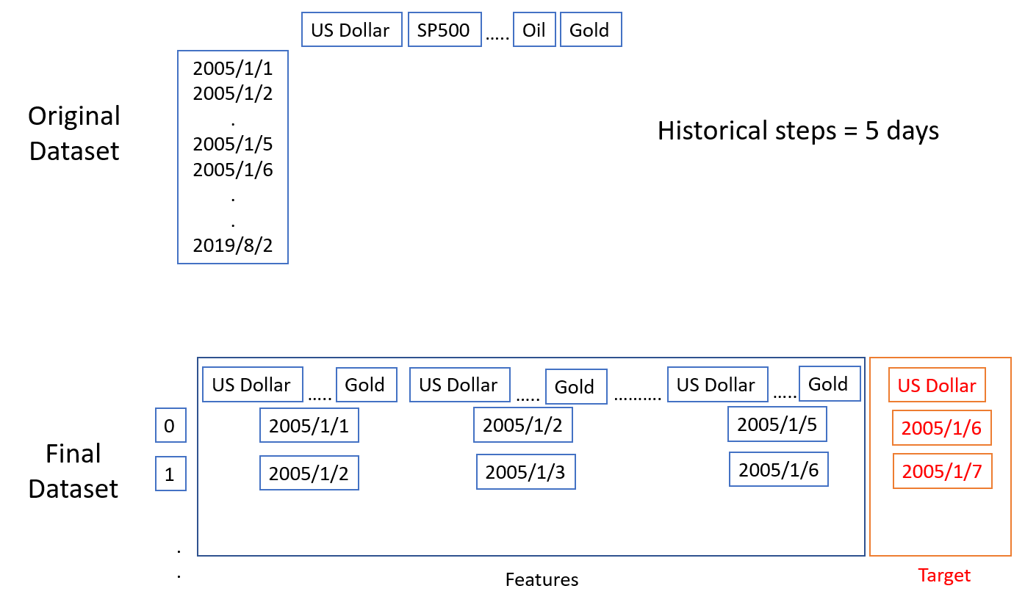
Reshape Data
Base on the concept of autoregression, I use the observations from previous 5 days as input to predict the value for next day.

Slide 4
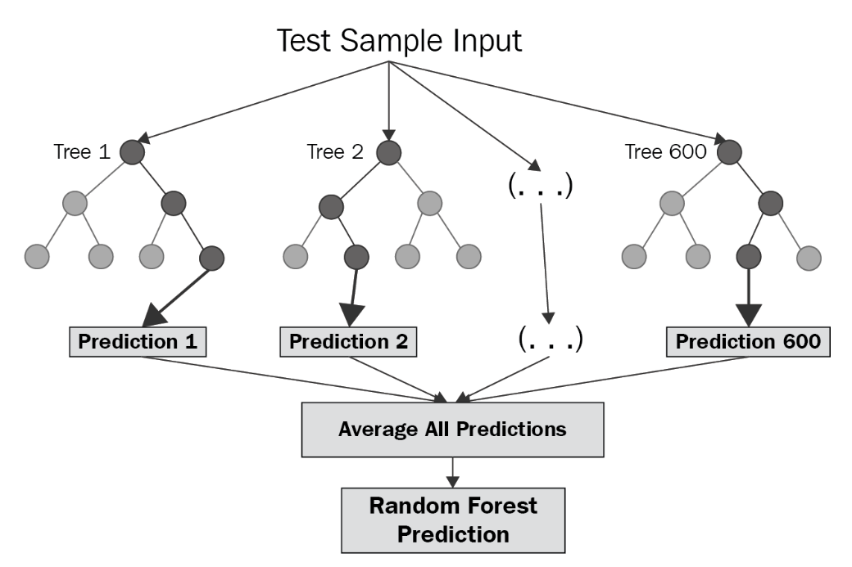
Use Random Forest to Perform Prediction
Train many trees and average predictions as the final prediction
Small number of samples and get pretty good results
Calculate feature importance automatically

Slide 5
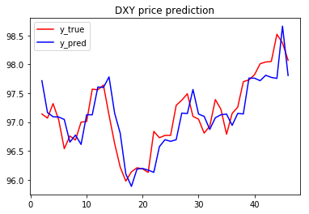
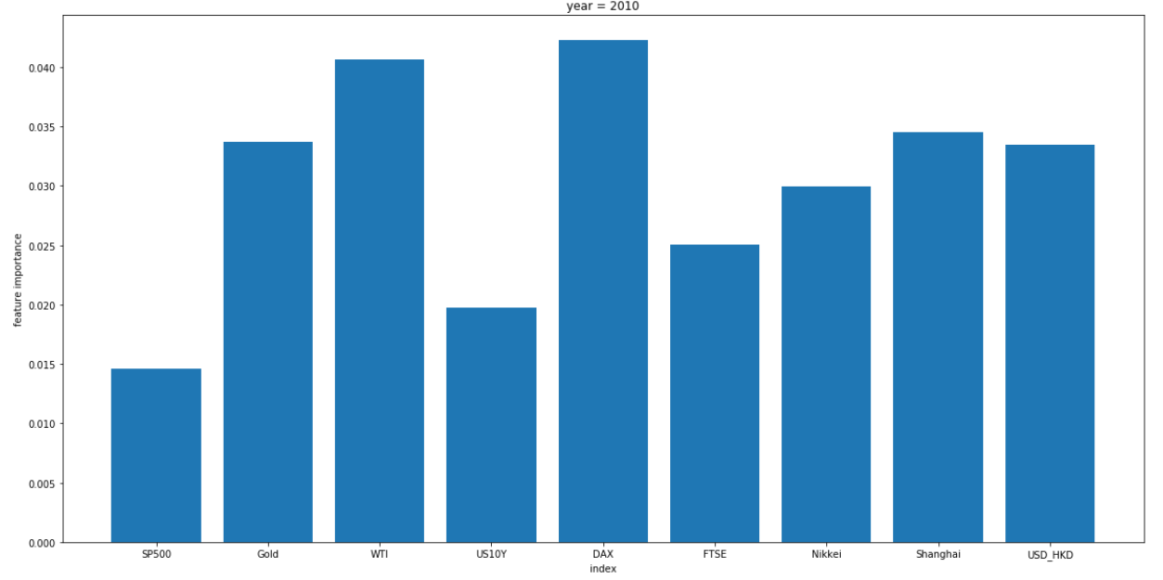
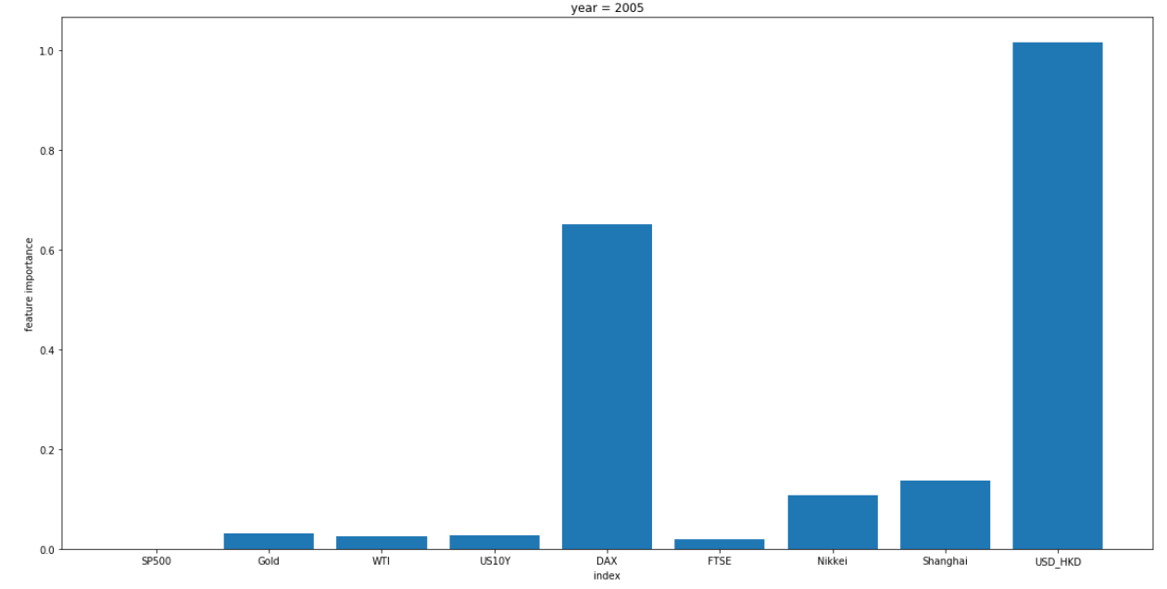
Some Results
2010
mse root: 0.337
r2_score: 0.69
2005

